Slide 1
Towards a Signature Based Compression Technique for Big Data Storage
Constantinos Costa | Panos K. Chrysanthis | Marios Costa
Rinnoco Ltd | Rinnoco Ltd | Rinnoco Ltd
Limassol, Cyprus | Limassol, Cyprus | Limassol, Cyprus
costa.c@rinnoco.com | panos@rinnoco.com | marios.c@rinnoco.com
Efstathios Stavrakis | Nicolas Nicolaou
Algolysis Ltd | Algolysis Ltd
Limassol, Cyprus | Limassol, Cyprus
stathis@algolysis.com | nicolas@algolysis.com
Partially supported by
4TH INTERNATIONAL WORKSHOP ON SELF-MANAGING DATABASE SYSTEMS
3 APRIL 2023, ANAHEIM, CALIFORNIA, USA

Slide 2
Outline
Motivation
Challenges
Solutions
SIBACO
Background & Related Work
SIBACO Overview
Experimental Methodology
Experiments
Conclusions & Future work

Slide 3
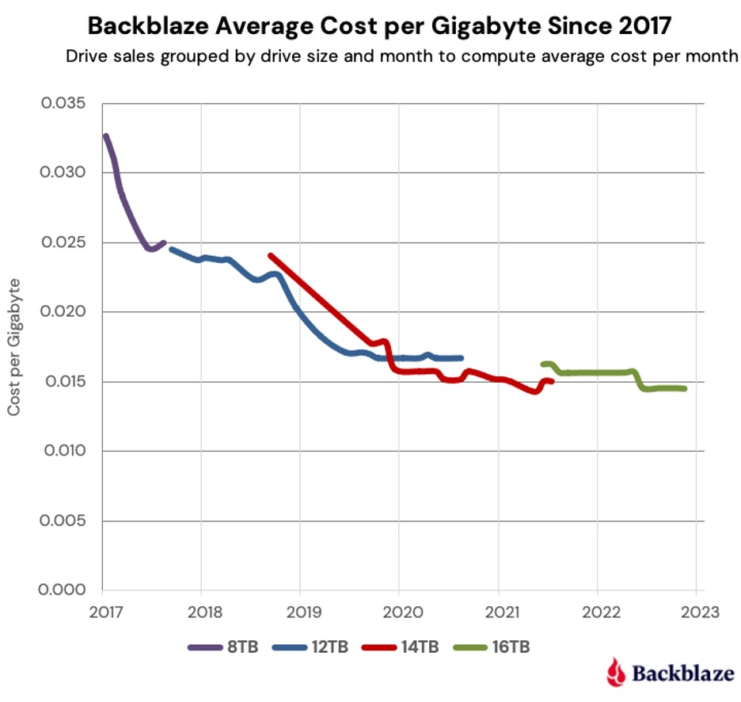
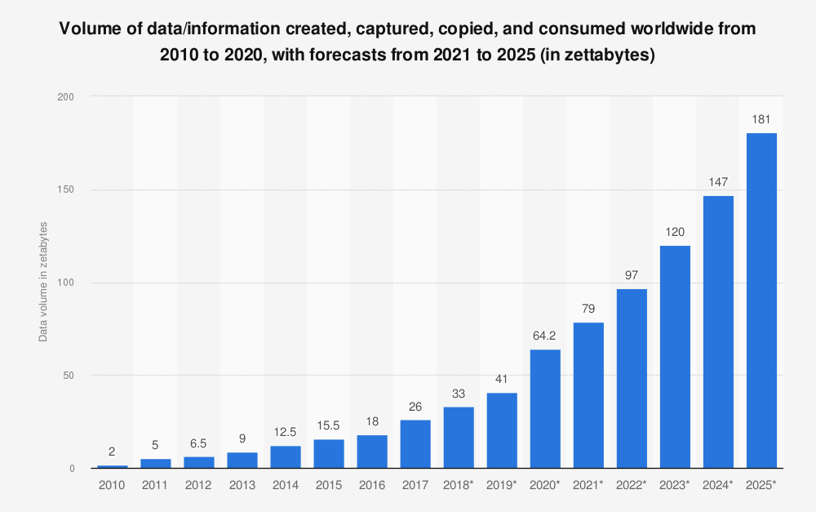
Motivation
Big Data is NOT dead:
IDC forecast: 181 ZB by 2025.
A one-hour Zoom group call requires between 360 MB and 1.2 GB of storage depending on the video quality.
Although the volume of electronically stored data doubles every year, storage capacity costs decline only at a rate of less than 15% per year.
Notes:
https://www.backblaze.com/blog/hard-drive-cost-per-gigabyte/

Slide 4
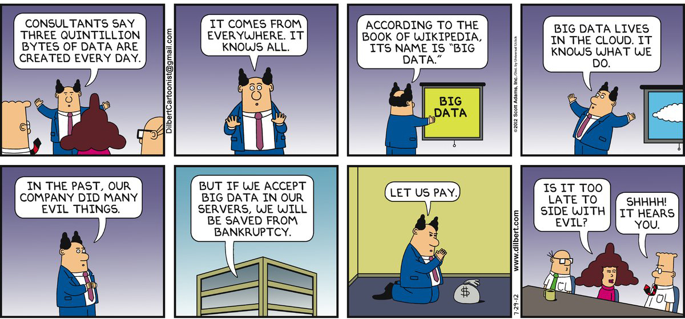
Big Data
Dilbert is back ☺
https://www.purpleslate.com/the-data-science-struggle-the-dilbert-way/

Slide 5
Challenges
The main challenges associated with Big Data are:
Storage
With the increasing amount of data being generated, storage is becoming a major challenge for many organizations.
Bandwidth
Transmitting large amounts of data over a network can be a bottleneck, especially when the available bandwidth is limited.
Processing
Big data requires large amounts of processing power to analyze and extract insights (large number of disk I/O and memory operations).
Cost
Storing and processing large amounts of data can be expensive.

Slide 6
Solutions
Distributed computing
Processing of data across multiple computers
Reducing the time required to process the data.
Machine learning
Analyze and extract insights from large volumes of data
Identify patterns, trends, and anomalies.
Data visualization
Represent complex data in a more intuitive and easily understandable form.
Compression
Size of data
Storage space required, speed of data transfer, and process the data (less I/O).
How we can exploit the compression to make it more cost-effective to store, process, and analyze large amounts of data?

Slide 7
SIBACO: Signature Based Compression
SIBACO’s hypothesis is that multi-scheme data compression is more effective for complex big data by enabling incremental compression and partial decompression.
Multi-scheme data compression uses different compression schemes that are more effective to be used for different columns based on their type and data characteristics (signature).
SIBACO supports data-intensive applications, many of which need to be able to perform exact queries over stored data. Therefore we are exploring only lossless compression techniques.

Slide 8
Background & Related Work
Compression techniques have been researched for over three decades in databases.
Most of the popular RDBMs are using a “monolithic” style compression scheme (e.g., PostgreSQL and MySQL) or a user-defined configuration and schemes (e.g., MSSQL and Oracle).
Column stores have been integrating compression to reduce storage costs for big data requirements (e.g., C-store). Additionally, several column stores have adopted a multi-scheme techniques
Black-box and with white-box ideas have been proposed to exploit the partitioning of the data with compression.
We can divide the lossless compression techniques into 4 categories.
Dictionary-based compression
e.g., LZ77, LZ78, LZW
Statistical compression
e.g., Huffman coding
Transform-based compression
e.g., Burrows-Wheeler Transform
Hybrid compression
e.g., DEFLATE, which combines LZ77 and Huffman coding

Slide 9
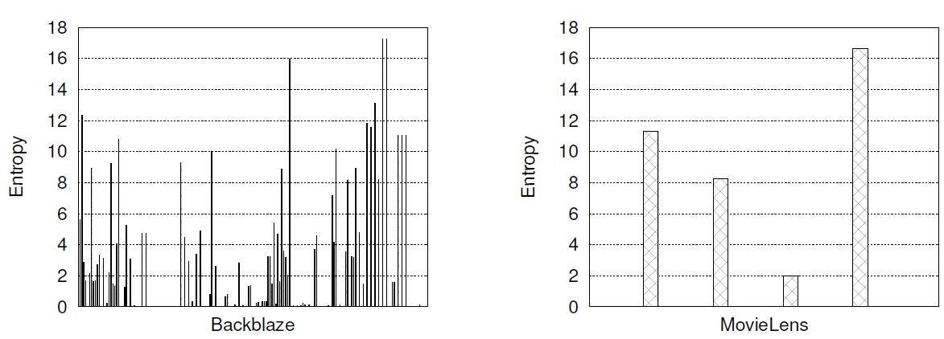
Compression & Entropy
Entropy is a metric used to evaluate the effectiveness of a compression algorithm.
The low-entropy attributes confirm that high compression ratios can be achieved.
The 0 entropy attributes are usually optional attributes for future use, thus they are empty or not used, but still stored.

Slide 10
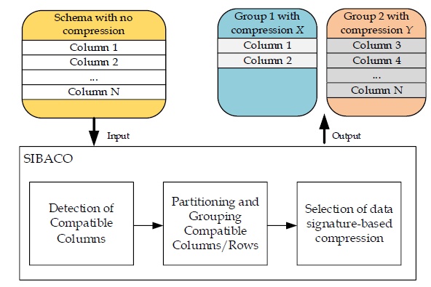
SIBACO Overview
Detection of compatible columns
The output of this stage is a table with the entropy of each column.
Partitioning and grouping of compatible columns/rows
The first group consists of the columns less than the threshold min(entropy) + θ, where θ is set based on empirical data (e.g., θ = 0.3).
The remaining columns with entropy greater than threshold form the second group.
Selection of data type-based compression
Selects the most appropriate compression algorithm using a knowledge base with different data characteristics (e.g., entropy, data distribution and types).

Slide 11
Experimental Methodology
Compression Algorithms*:
Compared Techniques:
DEFLATED: uses a combination of LZ77 and Huffman coding.
BZIP2: uses a combination of the Burrows-Wheeler transform and Huffman coding.
LZMA: uses a combination of dictionary compression scheme, similar with LZ77, and arithmetic logic.
BASELINE: This is the baseline (“monolithic”) technique, which compresses the data being agnostic of the data characteristics. It compresses all the data with only a single compression scheme.
SIBACO-BASIC: This is the basic approach of our proposed technique that uses a single compression scheme.
SIBACO: This is our proposed technique that uses multiple compression schemes.
*We chose the following algorithms because they are good representatives of the compression categories and are readily available from the zipfile library.

Slide 12
Experiments: Datasets
Backblaze: (∼20GB)
MovieLens: (∼645MB)
This dataset is a subset of the publicly available hard drive metrics released by Backblaze. In our experiments we have only included data for the year 2022 (Q1-Q3). The data contains daily snapshots of more than 100.000 operational drives in a datacenter. The daily snapshot of each drive is represented by one row that captures basic drive metadata (i.e., serial number, device model, capacity) as well as SMART Attributes metrics. This dataset has 178 attributes and a total size of ∼20GB.
This dataset is a subset of the real-word MovieLens dataset collected by the GroupLens research laboratory. It contains 25 million ratings and one million tag applications applied to 62,000 movies by 162,000 users. This dataset has four attributes and and has a total size of ∼645MB.

Slide 13
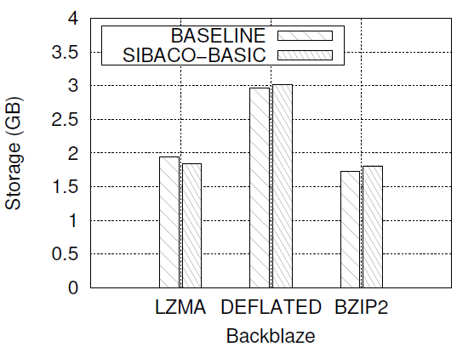
Experiments: Backblaze
SIBACO-BASIC splits 178 columns of the Backblaze dataset in two groups using θ = 0.3.
The first group consists of 73 columns with entropy close to 0, which was generated in the first stage of our technique. The second group consists of the remaining 105 columns
SIBACO-BASIC outperforms the BASELINE technique by up to ∼5% using LZMA for the Backblaze dataset
LZMA and BZIP2 yield better compression than DEFLATED by up to ∼66% for both techniques.
This experiment indicates that the compression can affect how our proposed technique works by selecting the most appropriate compression scheme using the SIBACO knowledge base

Slide 14
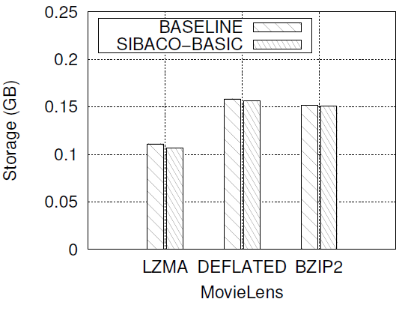
Experiments: MovieLens
SIBACO-BASIC splits the four columns of the MovieLens dataset in two groups using θ = 0.3.
The first group consists of one column with the smallest entropy. The second group consists of the remaining three columns.
SIBACO-BASIC outperforms BASELINE for all compression schemes by up to ∼4%.
This experiment indicates that even grouping similar columns together can yield to better performance.

Slide 15
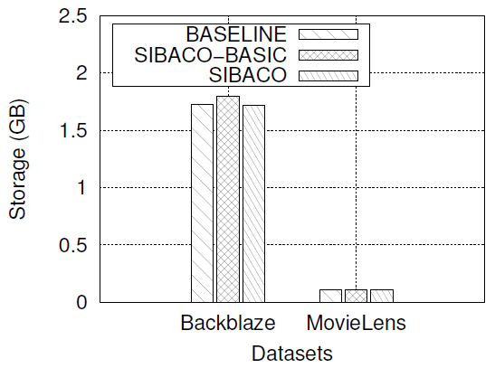
Experiments: Both Datasets
SIBACO (with multiple compression schemes) compares to the Baseline and SIBACO-BASIC approaches (that use a single compression scheme – BZIP2).
SIBACO selects the best performing compression schemes for a group based on the previous experiments.
SIBACO achieves up to ∼4% better performance against BASELINE.

Slide 16
Conclusions & Future Work
We describe the first SIBACO prototype that utilizes entropy to group columns and select the most appropriate compression scheme based on experimentally developed knowledge base.
SIBACO prototype using three compression algorithms and two real datasets can achieve up to ∼4% reduction in storage space against the competitors.
These first results are very encouraging since the current version of SIBACO does not utilize an extended knowledge base for compression signatures, and considers a limited number of compression scheme.
In our next steps, we aim to fully implement and refine all stages of our technique that can be easily plugged in storage systems, and develop a comprehensive knowledge base for compression signatures via analytical and experimental methods.
Exploit Machine Learning techniques to make SIBACO more robust and expand its functionality.

Slide 17
Towards a Signature Based Compression Technique for Big Data Storage
Thank you! Questions?
Constantinos Costa | Panos K. Chrysanthis | Marios Costa
Rinnoco Ltd | Rinnoco Ltd | Rinnoco Ltd
Limassol, Cyprus | Limassol, Cyprus | Limassol, Cyprus
costa.c@rinnoco.com | panos@rinnoco.com | marios.c@rinnoco.com
Efstathios Stavrakis | Nicolas Nicolaou
Algolysis Ltd | Algolysis Ltd
Limassol, Cyprus | Limassol, Cyprus
stathis@algolysis.com | nicolas@algolysis.com
Partially supported by
4TH INTERNATIONAL WORKSHOP ON SELF-MANAGING DATABASE SYSTEMS
3 APRIL 2023, ANAHEIM, CALIFORNIA, USA

